Slide 1


Variable Scopes in C
Explore the fascinating world of variable scopes in the C programming language and uncover the significance of this fundamental concept.

Slide 2
What is a Variable Scope?
Definition
Importance
Benefits
Variable scope refers to the region of a program where a variable can be accessed and manipulated.
Understanding variable scopes is crucial for writing efficient and bug-free code.
Proper variable scoping improves code readability, reduces naming conflicts, and optimizes memory usage.

Slide 3

Global Variables
1
Definition
2
Scope and Lifetime
3
Example
Global variables are declared outside of any function and can be accessed from any part of the program.
Global variables have a global scope, meaning they are visible throughout the entire program's execution.
int count = 0; is a global variable that can be used and modified by any function in the program.

Slide 4
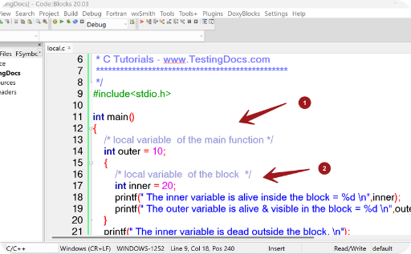
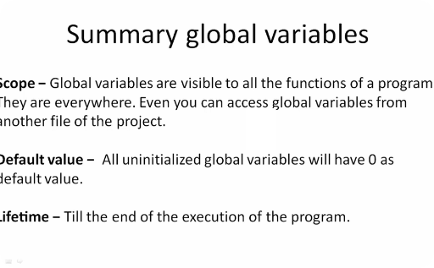
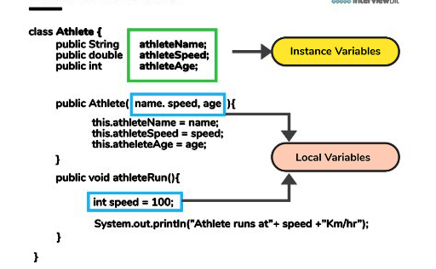
Local Variables
Definition
Scope and Lifetime
Example
Local variables are declared within a specific function and can only be accessed within that function.
Local variables have a local scope and their lifetime is limited to the duration of the function's execution.
int age = 25; is a local variable that can only be used within the function where it is declared.

Slide 5

Static Variables
1
Definition
Static variables are declared inside a function, but unlike local variables, they retain their value between function invocations.
Scope and Lifetime
2
Static variables have a local scope, similar to local variables, but their lifetime extends beyond the function.
3
Example
static int counter = 0; is a static variable that maintains its value across multiple function calls.

Slide 6

Block Scope Variables
1
Definition
2
Scope and Lifetime
Block scope variables are declared within a block of code, such as within a loop or conditional statement.
Block scope variables are limited to the block in which they are declared and have a short lifetime.
3
Example
char letter = 'A'; is a block scope variable that exists within a specific block of code.

Slide 7
Recap and Conclusion
By understanding the various variable scopes in C, you can write more efficient and organized code, minimizing bugs and enhancing overall program performance.

